Slide 1
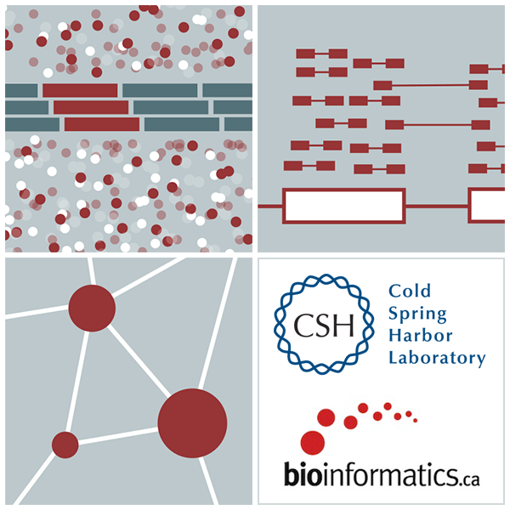
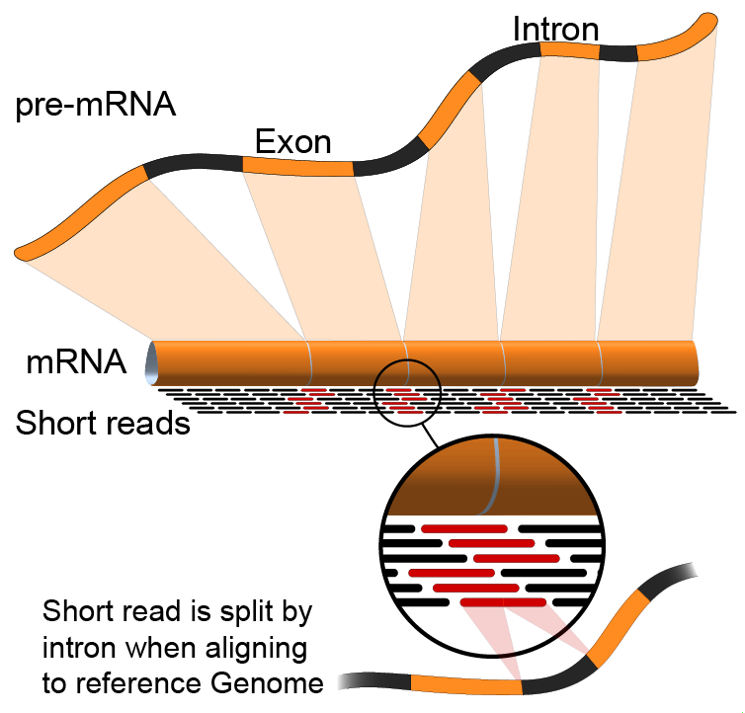

RNA-Seq Module 2 SAM/BAM/BED file formats
Felicia Gomez, Obi Griffith, Malachi Griffith, Chris Miller
Elizabeth Garfinkle, My Hoang, Charlz Jerold, Mariam Khanfar ,Kartik Singhal, Jennie Yao
Advanced Sequencing Technologies & Bioinformatics Analysis November 9-22, 2025

Slide 2
What is a sequence read?
(a.k.a. “a read”)

Slide 3
Slide courtesy of Andrew Farrell

Slide 4
Slide courtesy of Andrew Farrell

Slide 5
Slide courtesy of Andrew Farrell

Slide 6
FASTQ files are generally used to store short-read data from high-throughput sequencing experiments.
The sequence and quality scores are usually put into a single line
Slide courtesy of Andrew Farrell

Slide 7
Slide courtesy of Andrew Farrell

Slide 8
FASTQ files encodes phred scores as ASCII characters
Phred quality scores characterize the quality of DNA sequences – these scores are assigned by the sequencer
A quality score of 20 (Q20) represents an error rate of 1 in 100 (meaning every 100 bp sequencing read may contain an error); call accuracy of 99%.
Slide courtesy of Andrew Farrell

Slide 9
Higher Q scores indicate a smaller probability of error.
Lower Q scores indicate lower confidence in the called base.
Increased false-positive variant calls
Q30 is a standard a benchmark for quality in next-generation sequencing
Slide courtesy of Andrew Farrell

Slide 10
ASCII = American Standard Code for Information Interchange
Every text symbol must have an integer value representing it inside the computer
An ASCII code is the numerical representation of a character such as 'a' or '@'
Image courtesy of Andrew Farrell

Slide 11
FASTA format
We start with a reference genome to map to
The reference sequence (chromosome)
Sequence description
>20 dna:chromosome chromosome:GRCh37:20:1:63025520:1
NNNNNNNNNNTACTTCGATTGCGTATTTACGGACGTAGCGAGTCTTTAGAGTCTTTTAGTCTGTATC
GTCGTAGTGTCAGTTCGTAGTCTATGTCGTATTCGTAGGCGTACGTAGTCGTGTAGTCAGTCGTGTT
DNA sequence
http://en.wikipedia.org/wiki/FASTA_format
Slide courtesy of Andrew Farrell

Slide 12
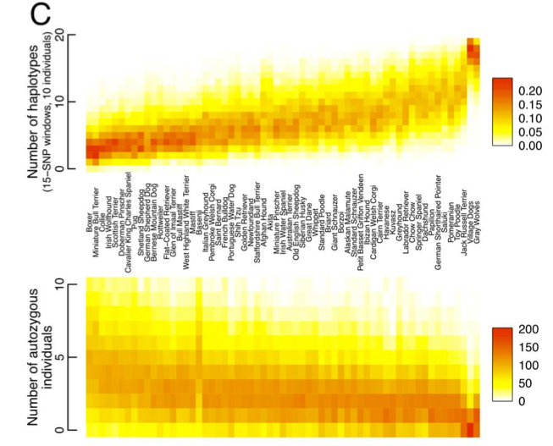
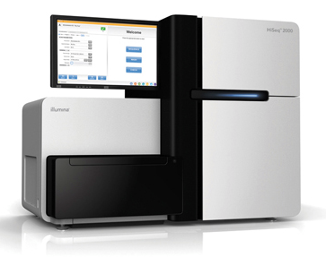
The goal. Easy, right?
FASTQ
cctaaccct
acccctgg
tcccctgg
acccctgg
cctaaccct
ggccctgg
cctaaccct
acccctgg
acccctgg
actaaccct
cctaaccct
cctaaccct
acccctgg
acccctgg
cctaaccct
cctaaccct
Sequence alignment is the crucial first step.
Slide courtesy of Aaron Qunilan

Slide 13

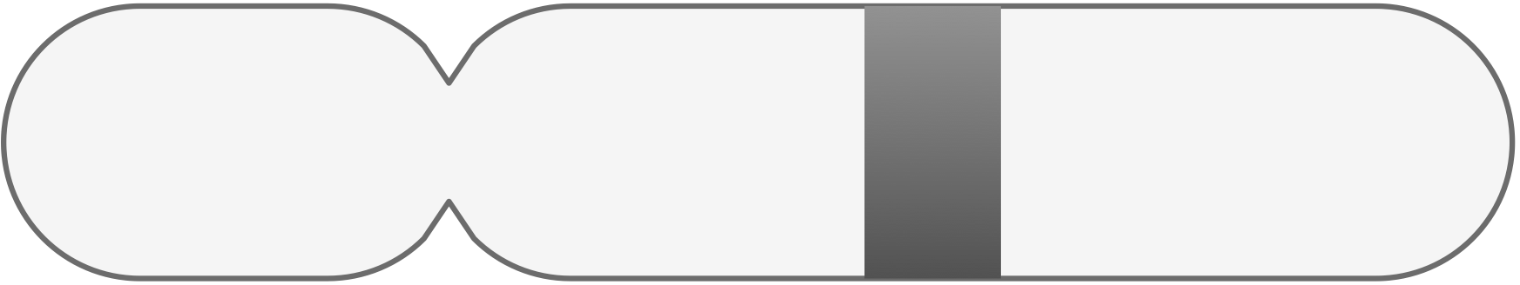
Aligning to a reference genome
This is like a jigsaw puzzle
Could fit here - but there are differences
Could fit here as well.
Slide courtesy of Andrew Farrell

Slide 14
Slide courtesy of Andrew Farrell

Slide 15
Sequence both ends of a fragment of DNA
Slide courtesy of Andrew Farrell

Slide 16
Sequence both ends of a
fragment of DNA
Slide courtesy of Andrew Farrell

Slide 17
Sequence both ends of a
fragment of DNA
Slide courtesy of Andrew Farrell

Slide 18
Paired end reads
Mate 1
Mate 2
X
X
X
Insert
mapped uniquely
mapped to multiple locations
unmapped
Slide courtesy of Andrew Farrell

Slide 19
Paired end reads
Mate 1
Mate 2
X
X
X
Insert
mapped uniquely
mapped to multiple locations
unmapped
Both mates map uniquely
Slide courtesy of Andrew Farrell

Slide 20
Paired end reads
Mate 1
Mate 2
X
X
X
Insert
mapped uniquely
mapped to multiple locations
unmapped
One mate maps uniquely, the other is unmapped
Slide courtesy of Andrew Farrell

Slide 21
Paired end reads
Mate 1
Mate 2
X
X
X
Insert
mapped uniquely
mapped to multiple locations
unmapped
One mate maps uniquely, the other maps
to multiple locations
Slide courtesy of Andrew Farrell

Slide 22
What needs to be stored?
Here?
Or here?
Where did the read map?
How confident are we that we are correct?
Which strand does the read come from?
Are there any differences with the reference?
What is the DNA sequence?
What are the quality scores for each base in the read?
What do we know about the mate?
Which read group does the read belong to?
http://samtools.github.io/hts-specs/SAMv1.pdf
Slide courtesy of Andrew Farrell

Slide 23

What needs to be stored?
Where did the read map?
How confident are we that we are correct?
Which strand does the read come from?
Are there any differences with the reference?
What is the DNA sequence?
What are the quality scores for each base in the read?
What do we know about the mate?
Which read group does the read belong to?
http://samtools.github.io/hts-specs/SAMv1.pdf
Slide courtesy of Andrew Farrell

Slide 24
What needs to be stored?
Where did the read map?
How confident are we that we are correct?
Which strand does the read come from?
Are there any differences with the reference?
What is the DNA sequence?
What are the quality scores for each base in the read?
What do we know about the mate?
Which read group does the read belong to?
http://samtools.github.io/hts-specs/SAMv1.pdf
Slide courtesy of Andrew Farrell

Slide 25
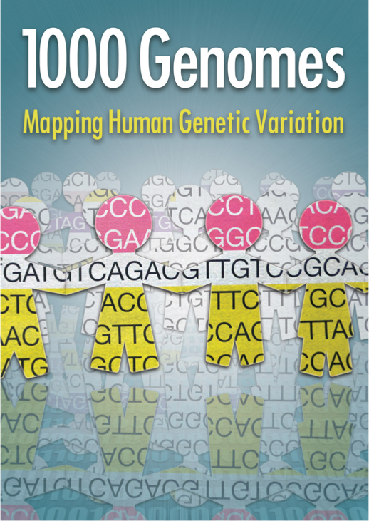
Store the alignment
Standardize alignment formats
SAM - Sequence Alignment/Map
Compressed (BAM) saves space
Can be indexed allowing fast access of regions
Simple format
Can represent single and paired end reads
Many toolkits now available to process data
http://samtools.github.io/hts-specs/SAMv1.pdf
Slide courtesy of Andrew Farrell

Slide 26
Introduction to the SAM/BAM format
The specification
http://samtools.sourceforge.net/SAM1.pdf
SAM is uncompressed text data
BAM is a compressed version of SAM
lossless BGZF format
BAM files are usually ‘indexed’
A ‘.bai’ file will be found beside the ‘.bam’ file
Indexing provides fast retrieval of alignments overlapping a specified region without going through all alignments.
BAM must be sorted by the reference ID and then the leftmost coordinate before indexing

Slide 27
Use samtools to convert SAM to BAM.
This takes a long time, but you do it once
Create BWT of reference genome.
$ bwa index grch38.fa
Output is in SAM format.
Use multiple threads if you have a computer with multiple CPUs.
Align paired-end FASTQ to BWT index.
$ bwa mem -t 16 grch38.fa 1.fq 2.fq > sample.sam
Output is in BAM format.
However, it is unsorted - that is, random genomic order as reads are randomly placed in FASTQ by sequencer.
Convert SAM to BAM
$ samtools view -Sb sample.sam > sample.bam

Slide 28
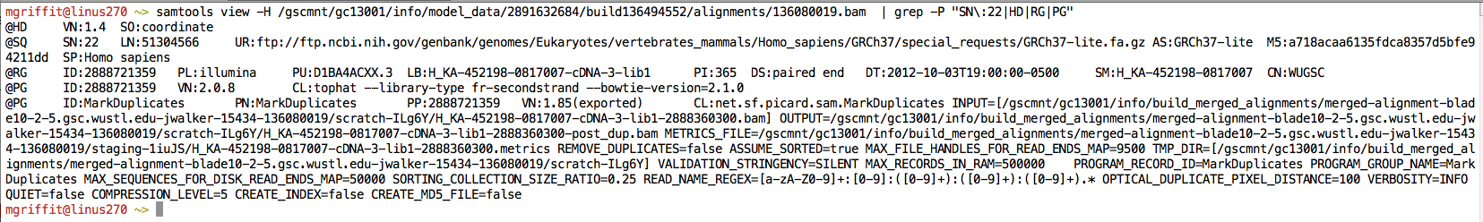
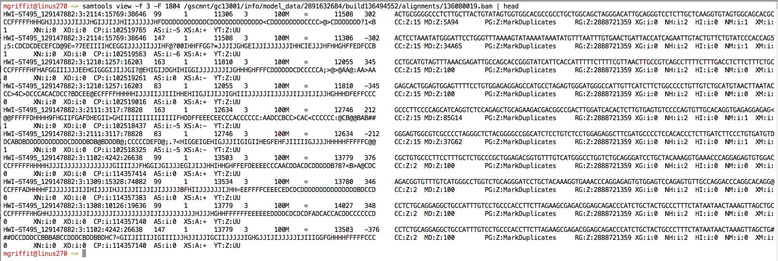
Example of SAM/BAM file format
Example SAM/BAM/CRAM header section (abbreviated)
Example SAM/BAM/CRAM alignment section (only 10 alignments shown)

Slide 29
SAM/BAM header section
Used to describe source of data, reference sequence, method of alignment, etc.
Each section begins with character ‘@’ followed by a two-letter record type code. These are followed by two-letter tags and values:
@HD The header line
VN: format version
SO: Sorting order of alignments
@SQ Reference sequence dictionary
SN: reference sequence name
LN: reference sequence length
SP: species
@RG Read group
ID: read group identifier
CN: name of sequencing center
SM: sample name
@PG Program
PN: program name
VN: program version

Slide 30
A BAM file is divided in header and alignment sections
Example SAM/BAM header section (abbreviated)
Version (VN) and sort order (SO) - Important!
Reference sequence (SQ)
and sequence length (LN)
Read group (RG) and sample (SM)
Programs (PG) that have been run on the data
Slide courtesy of Obi and Malachi Griffith

Slide 31
A BAM file is divided in header and alignment sections
Example SAM/BAM alignment section (only 10 alignments shown)
Slide courtesy of Obi and Malachi Griffith

Slide 32
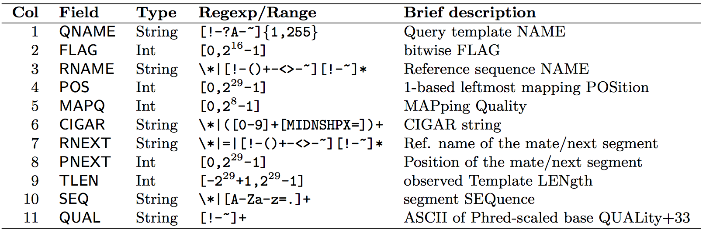
SAM/BAM alignment section
Example values
QNAME e.g. HWI-ST495_129147882:1:2302:10269:12362
FLAG e.g. 99
RNAME e.g. 1
POS e.g. 11623
MAPQ e.g. 3
CIGAR e.g. 100M
RNEXT e.g. =
PNEXT e.g. 11740
TLEN e.g. 217
SEQ e.g. CCTGTTTCTCCACAAAGTGTTTACTTTTGGATTTTTGCCAGTCTAACAGGTGAAGCCCTGGAGATTCTTATTAGTGATTTGGGCTGGGGCCTGGCCATGT
QUAL e.g. CCCFFFFFHHHHHJJIJFIJJJJJJJJJJJHIJJJJJJJIJJJJJGGHIJHIJJJJJJJJJGHGGIJJJJJJIJEEHHHHFFFFCDCDDDDDDDB@ACDD

Slide 33
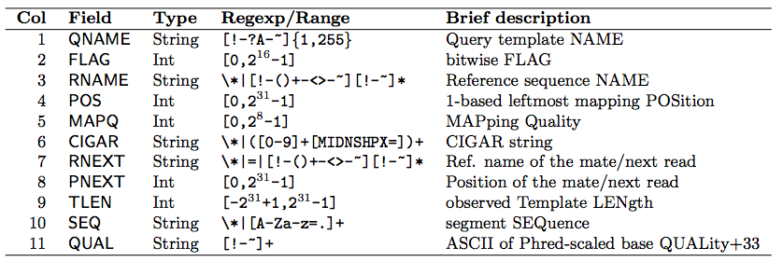
SAM Format – Information Fields
1
2
3
4
5
6
7
8
9
10
Slide courtesy of Andrew Farrell

Slide 34
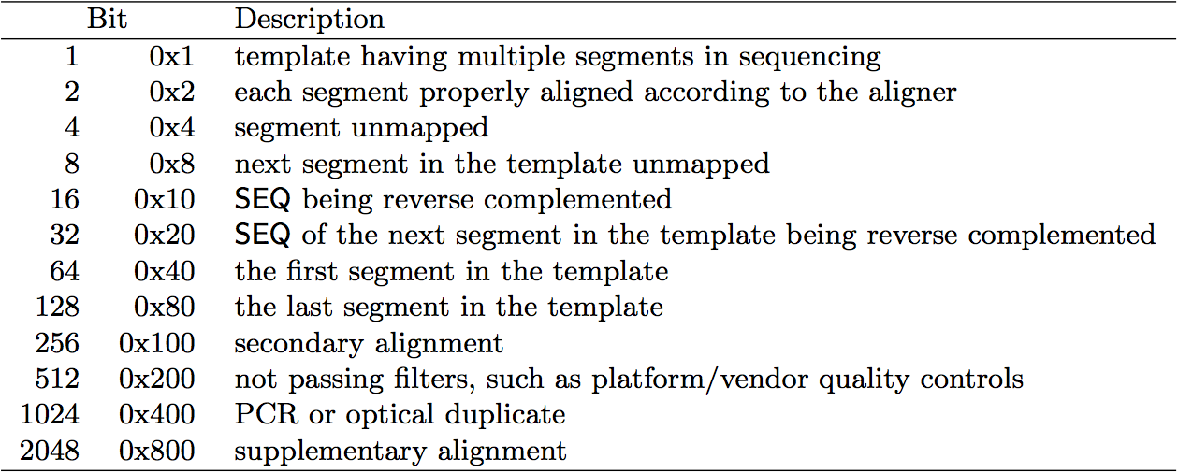
SAM/BAM flags explained
12 bitwise flags describing the alignment
Stored as a binary string of length 12 instead of 12 columns of data
Value of ‘1’ indicates the flag is set. e.g. 001000000000
All combinations can be represented as a number from 0 to 4095 (i.e. 2¹²-1). This number is used in the BAM/SAM file.
You can specify ‘required’ or ‘filter’ flags in samtools view using the ‘-f’ and ‘-F’ options respectively
Note that to maximize confusion, each bit is described in the SAM specification using its hexadecimal representation (i.e., '0x10' = 16 and '0x40' = 64).
http://broadinstitute.github.io/picard/explain-flags.html

Slide 35
ST-E00223:32:H5J57CCXX:4:1220:14651:8868 99
1
10086
base2 | base10 | base16 | Meaning | Applies to:
00000000001 | 1 | 0x0001 | The read originated from a paired sequencing molecule | Both
00000000010 | 2 | 0x0002 | The read is mapped in a proper pair | Pairs only
00000000100 | 4 | 0x0004 | The query sequence itself is unmapped | Both
00000001000 | 8 | 0x0008 | The query’s mate is unmapped | Pairs only
00000010000 | 16 | 0x0010 | Strand of the query (0 for forward; 1 for reverse strand) | Both
00000100000 | 32 | 0x0020 | Strand of the query’s mate | Pairs only
00001000000 | 64 | 0x0040 | The query is the first read in the pair | Pairs only
00010000000 | 128 | 0x0080 | The read is the second read in the pair | Pairs only
00100000000 | 256 | 0x0100 | The alignment is not primary | Both
01000000000 | 512 | 0x0200 | The read fails platform/vendor quality checks | Both
10000000000 | 1024 | 0x0400 | The read is either a PCR duplicate or an optical duplicate | Both
00001100011
2⁶+2⁵+2¹+2⁰ = 64+32+2+1 = 99
https://broadinstitute.github.io/picard/explain-flags.html

Slide 36
SAM Format – Information Fields
1
2
3
4
5
6
7
8
9
10
Slide courtesy of Andrew Farrell

Slide 37
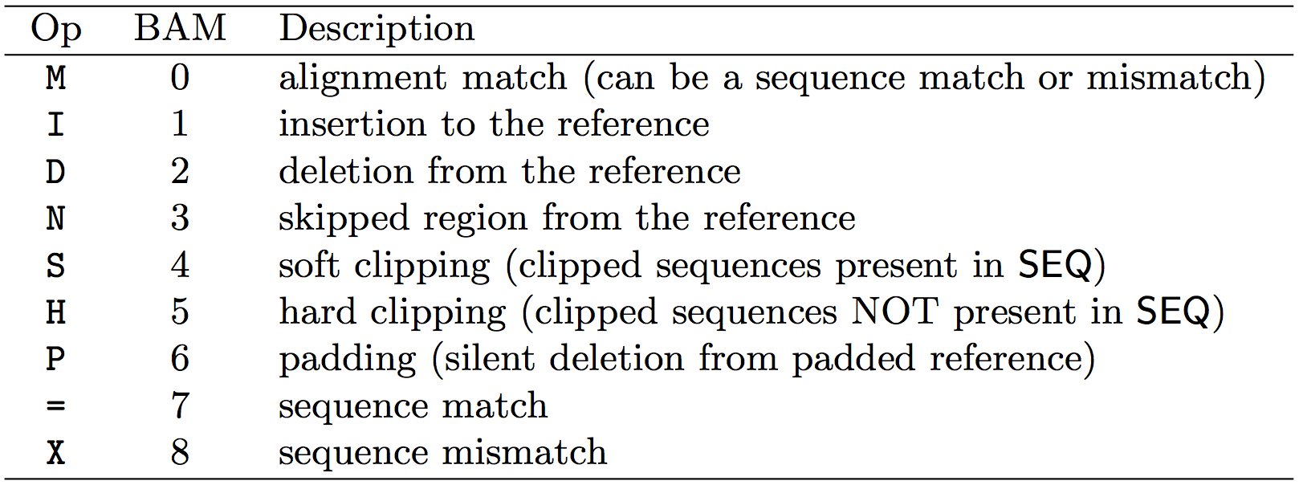
CIGAR strings explained
The ‘CIGAR’ (Compact Idiosyncratic Gapped Alignment Report)
The CIGAR string is a sequence of base lengths and associated ‘operations’ indicating which bases align to the reference (either a match or mismatch), are deleted, are inserted, represent introns, etc.
Reference:
Sample:
ACTTTTCATCCCTAAA---CAACC---CTGTGTTTTCCC
ACCGGTCAT---TAAATTTCAACCCTTCTGTGAAATCCC
9M3D4M3I5M3I12M
9M
3D
4M
3I
5M
3I
12M
2M3X4M

Slide 38
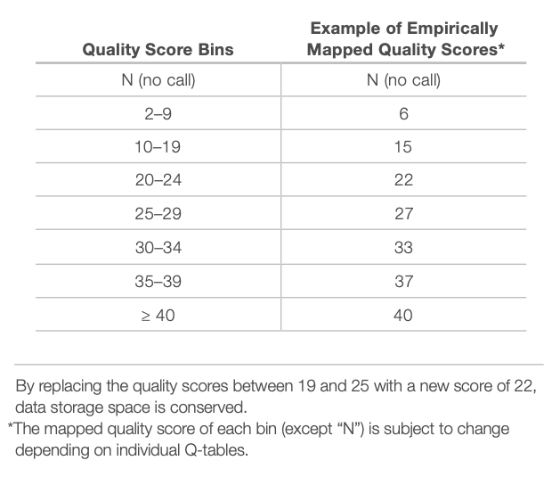
CRAM files
CRAM is an ultra-compressed version of a BAM file
Usually between 30-60% smaller than the corresponding BAM
Stores “diffs” from the reference genome
requires the matching reference genome to restore original data!
Base quality binning may be used as well
Some tools still require conversion back to bam

Slide 39
Introduction to the BED format
When working with BAM files, it is very common to want to examine a focused subset of the reference genome
e.g. the exons of a gene
These subsets are commonly specified in ‘BED’ files
https://genome.ucsc.edu/FAQ/FAQformat.html#format1
Many BAM manipulation tools accept regions of interest in BED format
Basic BED format (tab separated):
Chromosome name, start position, end position (BED3)
Coordinates in BED format are 0 based

Slide 40
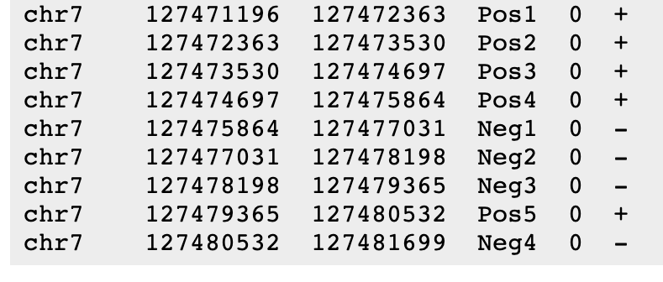
Introduction to the BED format
There are several flavors of BED format: BED3, BED4, BED6, BED8, etc.
First 3 fields always required: chr, start, stop
Followed by up to 9 additional optional fields: name, score, strand, thickStart, thickEnd, itemRGB, blockCount, blockSizes, blockStarts

Slide 41

Manipulation of SAM/BAM and BED files
Several tools are used ubiquitously in sequence analysis to manipulate these files
SAM/BAM files
samtools
bamtools
Picard
BED files
bedtools
bedops

Slide 42
Common sources of confusion
Genomic coordinate systems
Genome builds
Variant representation

Slide 43
Genomic coordinates – 1 vs 0 based
chr1 |  | T |  | A |  | C |  | G |  | T |  | C |  | A
1-based |  | 1 |  | 2 |  | 3 |  | 4 |  | 5 |  | 6 |  | 7
0-based | 0 |  | 1 |  | 2 |  | 3 |  | 4 |  | 5 |  | 6 |  | 7
 | 1-based | 0-based
Indicate a single nucleotide | chr1:4-4 G | chr1:3-4 G
Indicate a range of nucleotides | chr1:2-4 ACG | chr1:1-4 ACG
Indicate a single nucleotide variant | chr1:5-5 T/A | chr1:4-5 T/A
1-based : Single nucleotides, variant positions, or ranges are specified directly by their corresponding nucleotide numbers
GFF, SAM, VCF, Ensembl browser, …
0-based: Single nucleotides, variant positions, or ranges are specified by the coordinates that flank them
BED, BAM, UCSC browser, …

Slide 44
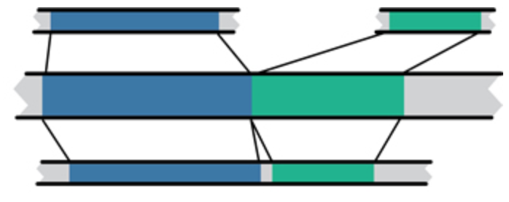
Genome builds
Reference Genome builds
Current human: GRCh38, hg38, b38
alternates: GRCh38v2_ccdg, GRCh38_full_analysis_set_plus_decoy_hla Previous human: GRCh37, hg19, b37 Current mouse: GRCm38, mm10
Lift-over
Mouse mm10
Human hg19
Human GRCh37
For a detailed discussion of various human reference genome flavors refer here:
https://pmbio.org/module-02-inputs/0002/02/01/Reference_Genome/

Slide 45
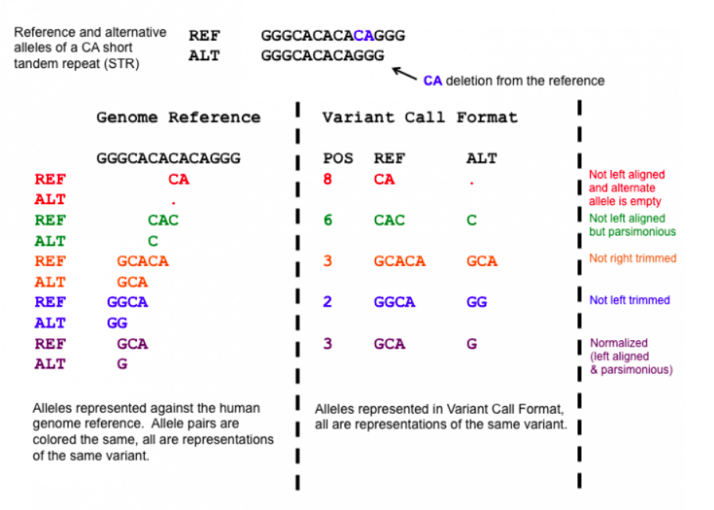
Variant shifting (alignment) and parsimony/trimming
Parsimony: representing variant in as few nucleotides as possible without reducing the length of any allele to 0
Left (right) aligning = shifting the start position of a variant as far to the left (right) as possible
Notes:
https://genome.sph.umich.edu/wiki/Variant_Normalization
Parsimony means representing a variant in as few nucleotides as possible without reducing the length of any allele to 0.
Left aligning a variant means shifting the start position of that variant to the left till it is no longer possible to do so.
The representation of variants in a VCF file requires that no alleles in the REF and ALT field are represented with an empty string (empty allele). The red indel has an illegal VCF representation.
The green variant is not left aligned as you can prefix an A nucleotide on the left side of the variant's alleles and truncate the C on the right side of the variant's alleles. It is however parsimonious.
The orange variant is left aligned but is not right parsimonious.
The blue variant is left aligned but not left parsimonious.
The maroon variant is left aligned and parsimonious.

Slide 46
How should I sort my SAM/BAM file?
Generally BAM files are sorted by position
This is for performance reasons
When sorted and indexed, arbitrary positions in a massive BAM file can be accessed rapidly
Certain tools require a BAM sorted by read name
Usually this is when we need to easily identify both reads of a pair
The insert size between two reads may be large
In fusion detection we are interested in read pairs that map to different chromosomes

Slide 47
We are on a Coffee Break & Networking Session

